Slide 1



2024 Fall Product Program
Parent Training
Notes:
”Welcome to the 2024 Fall Product Program Parent training.
Thank you for taking the time out of your busy schedule to learn more about and prepare for our program which starts September 21st.

Slide 2

Why your Girl Scouts should participate
Business Ethics
Decision Making
Goal Setting
Money Management
People Skills
Notes:
The Fall Product program is an easy and fun way to earn startup funds for troop activities at the beginning of the Girl Scout Membership Yea
It is an integral part of the Girl Scouts journey toward leadership, allowing girls to practice the following skills……
Business Ethics
Decision Making
Goal Setting
Money Management
People Skills
The Fall Product Program provides an opportunity for Girl Scouts to learn an or refine their leadership skills.
Girls will set a goal of how many products they would like to provide to their customers.
Girls have the opportunity to collaborate with other Girl Scouts to reach a common goal
Girls will use their presentation skills to create an avatar to personalize their website.
Girls provide customer service by receiving orders and delivering products

Slide 3
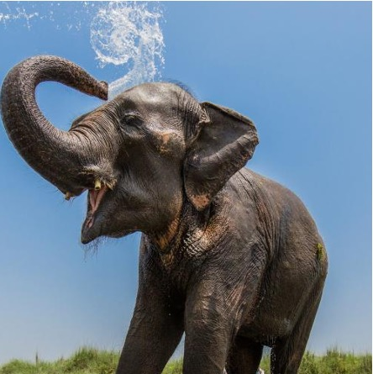
ASIAN ELEPHANT
Largest mammal on the Asian continent – living in forests
Up to 21 feet in length, 12 feet tall and up to 11,000 pounds
Very social spending 2/3 of the day feeding on grasses, bananas, rice and sugarcane
Endangered with fewer than 50,000 remaining due to habitat loss and poaching
Notes:
This 2024 Fall Product Program’s theme is “Embrace Possibility”. This is also the theme for the upcoming 2025 Cookie Program.
The mascot this year is the Asian Elephant.
The Asian elephant which lives in the forest, is the largest mammal on the Asian continent.
Growing up to 21 feet in length and 12 feet tall, the Asian elephant weighs up to 11,000 pounds. The Asian elephant is very social, spending 2/3 of the day feeding on grasses, bananas, rice and sugarcane.
The 2024 mascot raises awareness that the Asian elephant is endangered due to habitat loss and poaching.”

Slide 4

Get your Girl Scout ready to
Register your girl for 2024- 25 MY
Opt in to receive emails
Pick up Fall Product items from Troop Product Program Manager
Complete the online Parent Permission Form
Obtain your troop #, SU # and region
Registration for your M2 account begins on September 2
Help your Girl Scout Create an Avatar
Enter paper orders into the M2 System by October 30.
Notes:
Parents should verify the girls are registered for the 2024- 25 membership year.
Opt in through your myGS account to receive emails and updates during the Product Program Season.
The Girl Scout will obtain all Product Program materials from their troop Product Program Manager.
Compete the Parent Permission form. This from must be completed prior to participation in the Fall Product Program.
Be sure to enter your girl order card into the M2 system prior to 11:59pm on October 30. Contact your troop leader immediately if you are unable to enter your order card.
All Product Program materials can be found on the gshg.org website.

Slide 5
Fall Program Participation Options
 | Nuts/Chocolates |  |  | Magazines and More (Tervis Tumblers & BarkBox)
Type | In person | Online Girl Delivered | Direct ship | Online
Ordering Process | Girls collect money with orders. Girls submit money to Troop PPM. Family/troop enters orders into M2 by 11:59p.m. on October 30. | Girls create a M2 storefront and emails friends and family. Customers pay online. Girls are credited for their customer orders in M2. | Girls create a M2 storefront and emails friends and family. Customers pay online, including the cost of shipping. Orders are credited to the girls in M2. | Girls create a M2 storefront and emails friends and family. Customers select products and pay online. Orders are credited to the girls in M2.
Delivery Process | Girl delivers products to customer | Girl delivers product to customer | Direct ship to customers in 1-2 weeks | Direct ship to customers in 6-8 weeks
Troop proceeds | $1.25/item | $1.25/item | $1.25/item | $2.00/item
Notes:
When taking in person orders the Girl Scout should collect money due when adding supporter’s information to the girl order card.
Share your link to give supporters the opportunity to purchase items on-line.
Supporters can choose to have nuts and chocolates, shipped directly to them or have the option to select from a group of nut and chocolate products that the Girl Scout can deliver.
Magazines and more(Bark Box and Tervis Tumblers) can only be ordered online and shipped directly to customers.

Slide 6
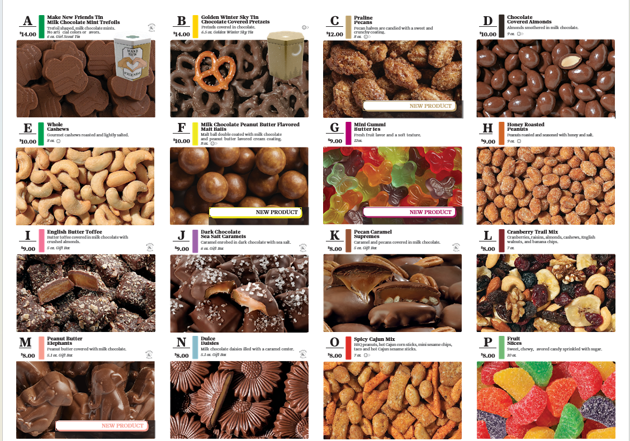
2024
Fall Product Line
Notes:
Customers can enjoy products from these 2024 product selections which include our top Selling items:
Pecan Supremes
Peanut Butter Elephants
Chocolate covered almonds
Dark chocolate sea salt caramels and the
Spicy Cajun Mix.
New this year we have three delicious item the:
Praline Pecans
Peanut Butter Malt Balls
And Gummi Butterfiles

Slide 7



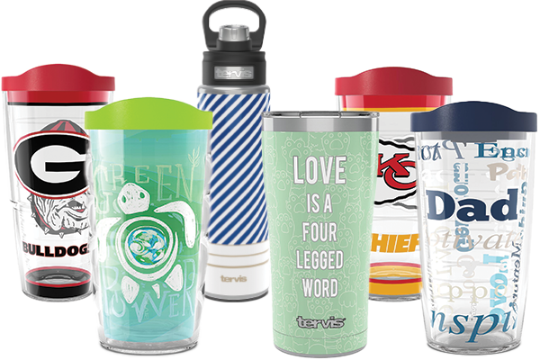

Magazines, Tervis Tumblers and BarkBoxes
Notes:
“Supporters can select from multiple item to support your Girl Scout with reaching their goals.
Participants offer supporters access to Bark Boxes,
top selling magazines with the online shopping option,
and a wide selection of premium Tervis® insulated tumblers and water bottles,
It is easy to renew current magazine subscriptions while at the same time supporting their Girl Scouts.
All choices are available online

Slide 8

TROOP PROCEEDS
$2 per Mags & More item sold
$1.25 per nut/chocolate item sold
Notes:
“Girl Scout goals work in tandem with the troop’s financial goals.
Each girl will earn $2 per magazine, Tervis tumbler or Bark box sold and earn $1.25 per nut/chocolate item sold
The Fall Product Program is an easy way to earn startup funds and begin to meet the troop’s goals for the year.”

Slide 9

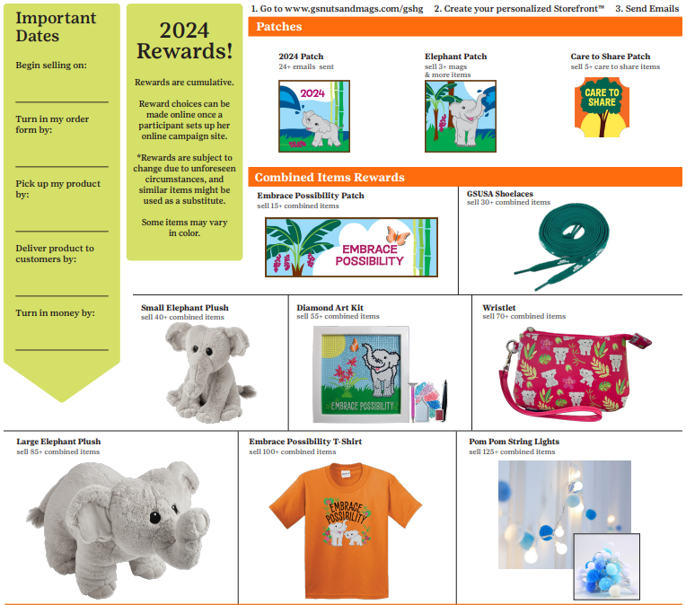
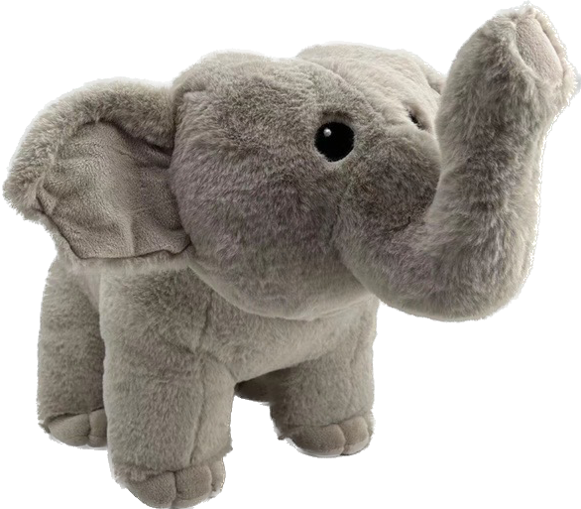
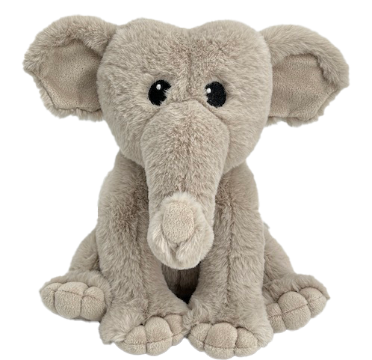
GIRL SCOUT REWARDS
Notes:
“Participating Girl Scouts have an opportunity to earn items from the GSHG rewards shown here, online on the M2 website and on the nut order card. ”

Slide 10

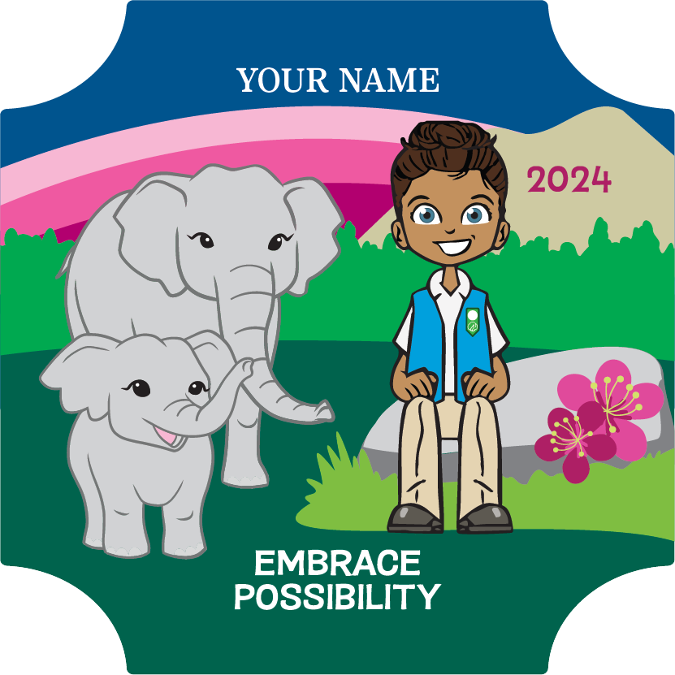
Fall Personalized Patch
Personalized Patch with
Theme Backgrounds
Create avatar
Send 24+ emails
“Share My Site”
Sell 5+ mags & more items
and 45+ nut/chocolate items
Notes:
“Girl Scouts engage digitally with supporters by designing their own avatar which is a way to help make the digital experience more personalized like connecting with supporters in person, but in the digital space.
Participants personalize their avatar, select the avatar’s background of the boat or the rock with the Asian elephant scene,
and include their name, nickname or initials on the patch.
Once the personalized patch is earned through in person and online efforts together, the patch is directly shipped to the mailing address provided after login.

Slide 11
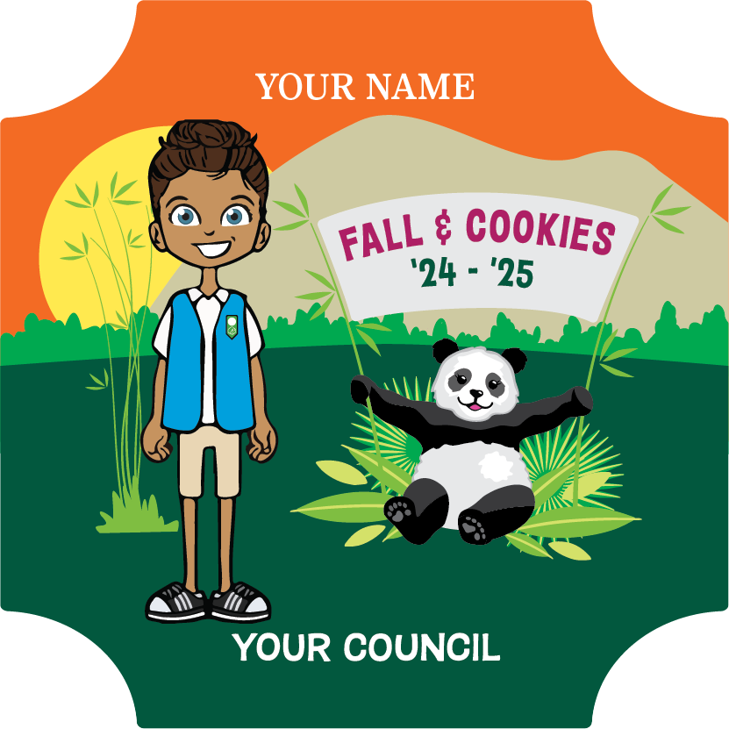
2024-25 FALL & COOKIE CROSSOVER PATCH
- Earn 2024 Fall Personalized Patch
- Sell 450+ packages of cookies and send 24+ digital cookie emails
Notes:
“Girl Scouts can also earn a Crossover patch during the 2025 Cookie Program that compliments the Personalized Patch.
This patch features the 2025 Cookie Program mascot and is earned by selling 450+ packages of cookies and sending 24+ digital cookie emails.

Slide 12
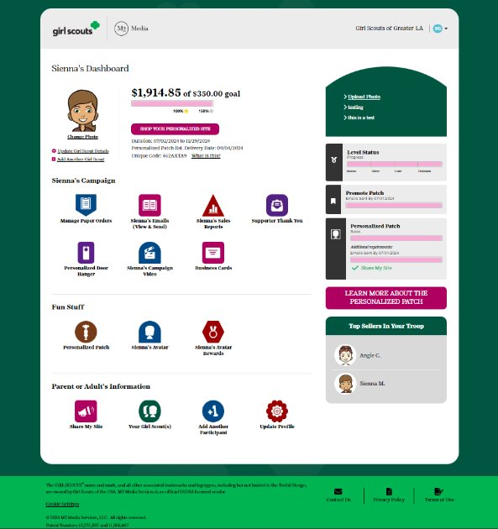

GIRL SCOUT’S PLATFORM SET-UP
Preferred Email Address
Confirm Membership
Highlight Girl Scout Goals
Build an Avatar
Include Video
Notes:
The Girl Scout should have her troop number available when logging in for the first time.
If a participant doesn’t see their troop number or name, complete the setup process and council will verify after complete.
Returning participants can use the same email address and password but need to confirm and complete the setup process.
The parent/caregiver and Girl Scout validate that you are with the Girl Scouts of Historic Georgia council with your zip code next, confirm your troop number, and then answer questions about goals and what Girl Scouting means.
Along the way, Girls build their virtual avatar likeness with the patented Girl Scout platform.
Girl Scouts sharing their goals for the Product Program through an individual or troop video has shown to significantly increase results too.”

Slide 13
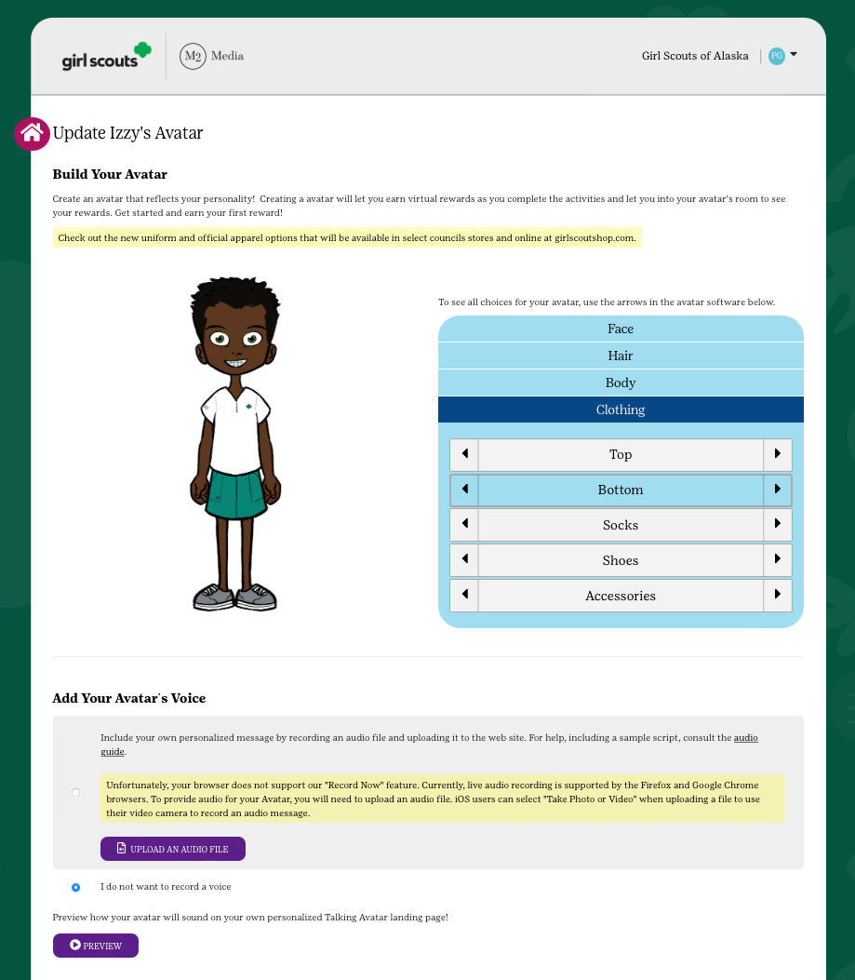
GIRL SCOUT’S PERSONALIZED
EXPERIENCE
Design an Avatar
Notes:
“Girl Scouts engage digitally with supporters by designing their own avatar.
This can help make the digital experience more personalized like connecting with supporters in person, but in the digital space.
Girl Scouts personalize their avatar, select the avatar’s background of the boat or rock with the Asian elephant scene, and include their name, nickname or initials on the patch.
Once the personalized patch is earned with the criteria highlighted, through in person and online efforts together,
the patch is directly shipped to the mailing address provided after login.”

Slide 14
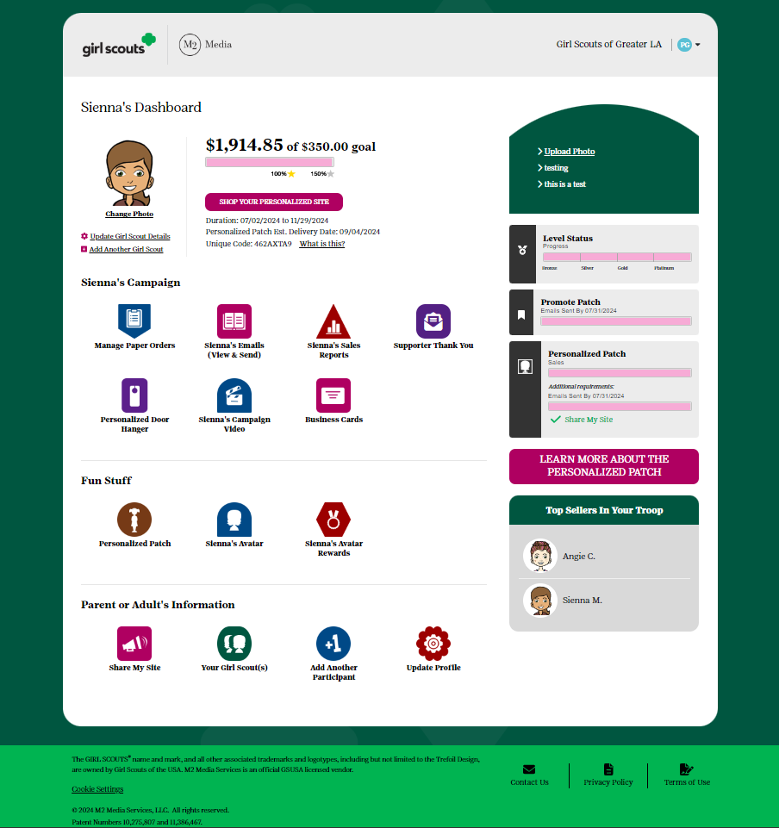
PARTICIPANT’S DASHBOARD
Additional emails/social media/texts
NEW Supporter Thank You email
Girl Scout’s avatar room with virtual rewards & troop photo
Manage nut card order entry
Select rewards
Sales reports
Notes:
Here is the participant’s online toolkit for managing both online sales and in person participation.
Girl Scouts can send additional emails, social media and texts from the participant’s Dashboard.
Girl Scouts visit their Avatars room 4 times on average during the program to see virtual rewards earned by completing actions and also the troop photo.
Parent/Adults and Girl Scouts enter in the totals of each item using the nut order card into the system prior to the end of the program’
Nut order card totals will be tabulated and added to all online sales totals in reports.
Rewards earned are automatically selected.
There are reports showing sales by category and specific reports highlighting girl delivered items sold online by supporter with contact information for in person nut and chocolate delivery.”

Slide 15
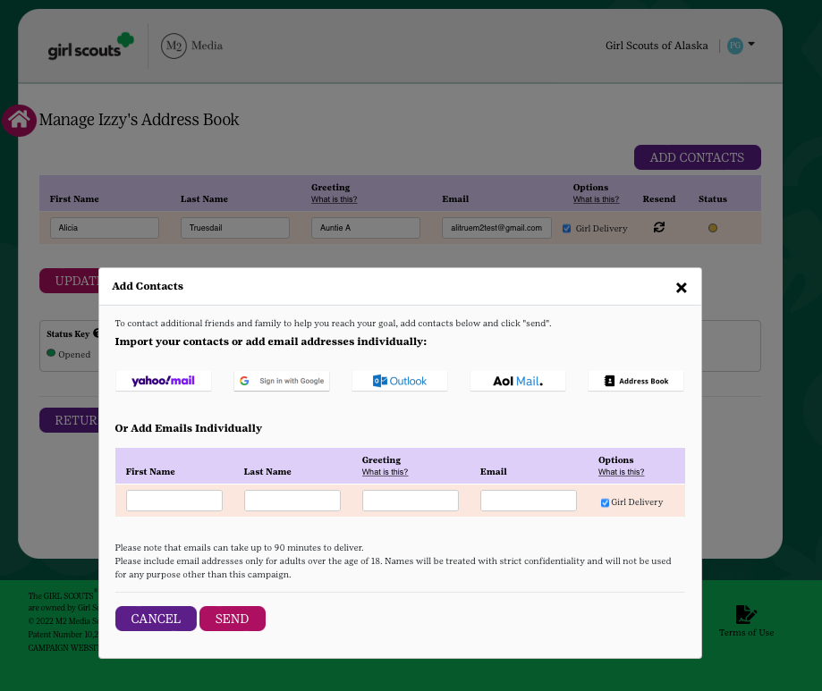
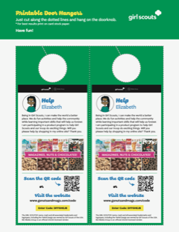
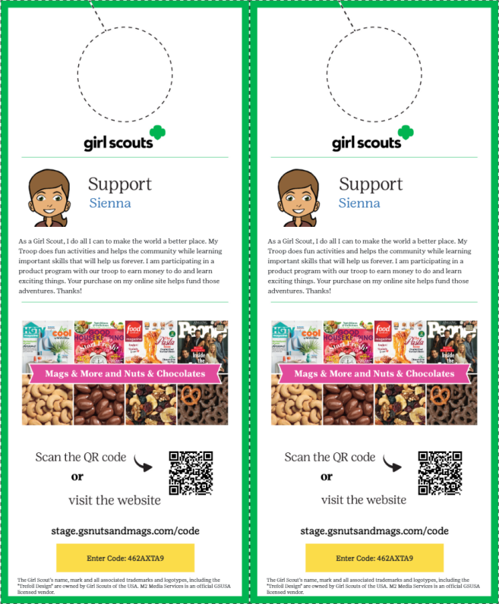
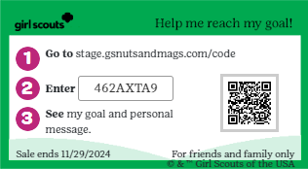
TOOLS TO RUN A BUSINESS
Send emails
Share My Site with social media and texting
Printable business cards
Door hangers with QR codes
Notes:
Girl Scouts can personalize their request for support based on the supporter’s preferences for each contact.
The most popular option is still sending emails with over 58% of sales coming from that channel.
Next in line is social media. Texting shares the participant’s personalized site conveniently for those using a smartphone.
The printable business cards and door hangers are effective printable tools to leave behind after contact with supporters.”

Slide 16
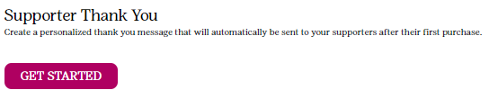
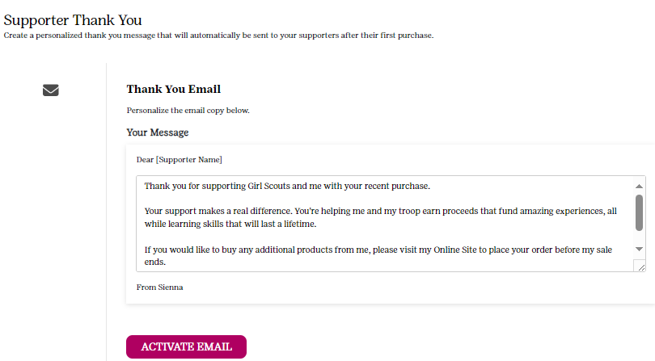
Say Thanks!
Notes:
New this year, Girl Scouts can say a personalized “Thank you!” to the supporters who purchase from their online storefronts.
Activating the Supporter Thank You email allows you an opportunity to say “Thanks for your support!” in you own special way.
Accessible from the Girl Scout’s dashboard, and can be turned on and off at any time throughout the program.”

Slide 17

Girl Scout Product Deliveries
Coordinate delivery
Click the Sales Report Icon M2 site
Click Online Nuts Girl Delivered tab
Notes:
Coordinate delivery of the product with customers.
Happy customers equal return customers!
Click the Sales Report Icon and click Online Nuts Girl Delivered tab to view where your Girl Scout will deliver products.
Participants may contact Customer Service for additional customer information if necessary for delivery.

Slide 18


Care to Share
A great way for customers to give back to the community through donations of products.
Donations will be given to the Georgia War Veterans Home located in Milledgeville, Georgia.
*For each $8.00 donation, veterans at the Georgia War Veterans Home or a local active-duty service member will be sent one Fall Product candy or nut item.
Donation are credited to the girl’s sales
Girls with 5+ items donated will earn the care to share patch.
Notes:
Care to Share is great way for customers to give back to the community through donations of products.
Girl Scout of Historic Georgia will make donations to the Georgia War Veterans Home located in Milledgeville, Georgia.
*For each $8.00 donation, veterans at the Georgia War Veterans Home or a local active-duty service member will be sent one Fall Product candy or nut item.
Donation are credited to the girl’s sales and troops receive $1.25 in proceeds per donated item.
Girls with 5+ items donated will earn the care to share patch.

Slide 19
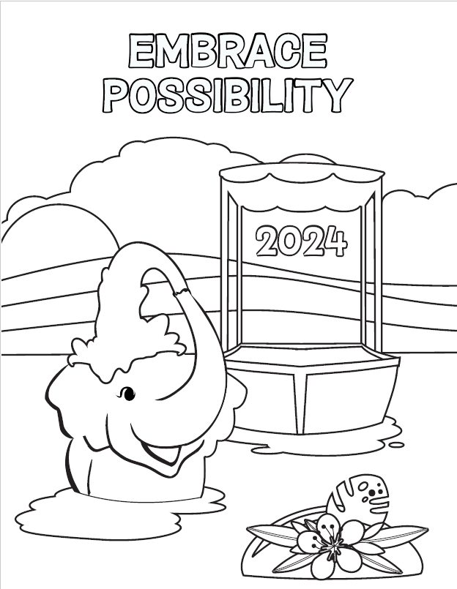
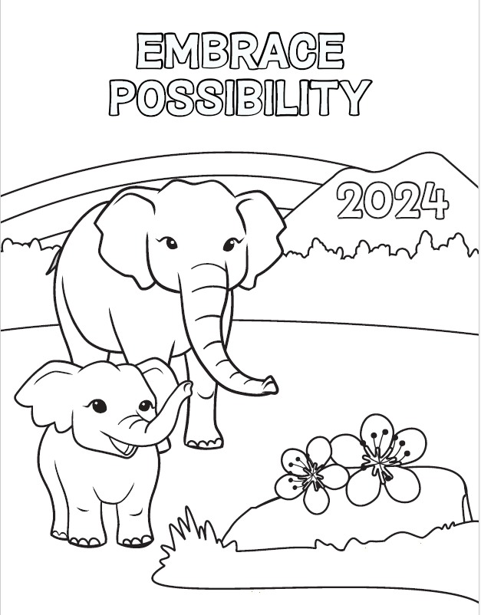
Coloring Contest
Notes:
Name the Elephant and give her a home!
Embrace Possibility by participating in the Fall Product Coloring Contest. Choose from these designs and use crayons, markers, color pencils, or paint to express your artistry.
Submit your coloring sheet to be entered in the drawing to name Girl Scouts of Historic Georgia’s Elephants. All entries must be submitted to your Regional Product Program Manager or Council Office by 5pm on October 30, 2024. All coloring sheets will be displayed in the regional offices.
The name you would like to give the Elephant should be written on the front of the coloring sheet. Write your troop number with your first and last name on the back of the coloring sheet.
The Elephant’s name will be announced at the conclusion of the program, during a virtual drawing.”

Slide 20
Product Program Proceeds
Deposited into troop account
Troop members collectively decide on how to use proceeds
Notes:
Product Program proceeds will be deposited in troop account and managed by the troop leader.
Contact your troop leader for any additional questions concerning troop proceeds

Slide 21
Things to Remember
Collect money when customer places order
Verify all orders prior to submission
No reorders
Submit money to troop leader frequently
Count to verify all products are included in order at pick up
Notes:
Collect payments when orders are placed
Verify all order
Once orders are submitted in the M2 system, no additional orders can be placed
It’s best to submit money to troop leader frequently to avoid mismanagement of money.
Count to verify all products are included in your order at product pick up

Slide 22

R-elephant Dates
9/21 - Fall Product Program KICKS OFF
10/30 –Parents and participants to submit paper order entries no later than 11:59 p.m.
10/31- Troops enter, verify and submit paper order no later than 11:59 p.m. (email SUPPM once submitted)
11/3 – Care to share deadline/ Fall Product Program Ends at 11:59 p.m.
Notes:
Please add the following dates to your calendar.
And be mindful of any modifications to these dates or additional deadlines provided by your troop leader.

Slide 23
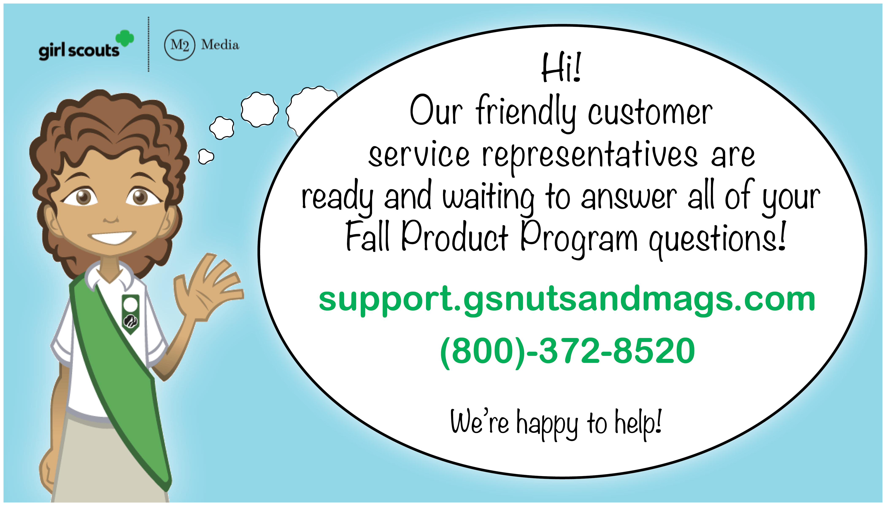
FALL PRODUCT PROGRAM CUSTOMER CARE
M2’S Customer Care team is cross-trained to handle tech support, caregiver/participant and customer inquiries.
100% customer satisfaction guarantee
Notes:
“M2’s Customer Care team is trained to handle support for participant and customer inquiries, Please contact them if there need arises.

Slide 24

Thank You!
Thank you so much for supporting your Girl Scout participation in Fall Product Programming!
Notes:
Thank you so much for supporting your Girl Scout participation in Fall Product Programming!

