Slide 1
2025 Cookie Program Training
Direct Delivery
Notes:
Welcome to the 2025 Cookie Program Training.
By taking this training, you are choosing to embrace the possibility of this season with fellow Girl Scouts.

Slide 2
Notes:
This year GSHG Girl Scouts will embrace possibility with our new friend Mei Lan.

Slide 3
Product Program Abbreviations
GOC – Gift of Caring
IO – Initial Order
PGA – Per Girl Average
SU – Service Unit
RPPM– Regional Product Program Manager
Notes:
Girl Scouts has its own language. Here are some must-know abbreviations for the Product Program Season.
Gift of Caring and Operation Cookies from Home are the programs through which Girl Scouts of Historic Georgia donates cookies.
The Initial Order is the first order that is placed with Little Brownie Baker and arrives the beginning of February
The per girl average is the average number of items sold per girl in each troop. Only the girls participating in the program with the troop will be included in the PGA.
The Service Unit is the area in which your Troop meetings are held.
Your regional product program manager is the staff member that manages product programming at your local Girl Scout office.

Slide 4
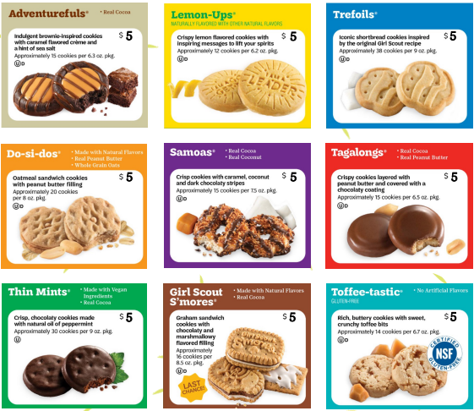
2025 Cookie Program Variety Line up
Cookie prices remain $5 a box.
This includes our specialty cookies S’Mores and Toffee-tastic.
Notes:
The 2025 Cookie Program Variety Lineup includes Adventurefuls, Lemon-Ups, Trefoils, Do-si-dos, Samoas, Tagalongs, Thin Mints, Girl Scout S’mores and Toffee-tastics.
Cookie Prices remain $5 a box including our specialty cookie S’Mores and Toffee-tastics.

Slide 5
GSHG cookies contain:
No high fructose corn syrup
Zero grams trans-fat per serving
No partially hydrogenated oils (PHOs)
RSPO certified (mass balance) palm oil
Halal certification
Notes:
Girl Scout of Historic Georgia Cookies contain:
No High Fructose Corn Syrup
No partially hydrogenated oils (PHOs)
Zero grams trans-fat per serving
RSPO certified palm oil
And are Halal certified

Slide 6
5 Essential Skills learned through the Cookie Program
Goal Setting
Decision Making
Money Management
People Skills
Business Ethics
Notes:
The Girl Scout Cookie Program helps Girl Scouts develop real – world skills in five essential areas that include Goal Setting, Decision Making, Money Management, People Skills and Business Ethics.
Girl Scouts learn how to set goals and create a plan to reach them.
Girl Scouts learn to make decisions on their own and as a team.
Girl Scouts learn to create a budget and handle money.
Girl Scouts find their voices and build confidence through customer interactions.
Girl Scouts learn to act ethically, both in business and life.
Visit www.gshg.org to learn more about inspiring cookie entrepreneurship

Slide 7
Notes:
The 2025 Cookie Season is the Final Season for Girl Scout S’mores.
Check the website LittleBrownie.com for final season resources.

Slide 8
Gift of Caring
2025 Cookie Donations will be sent to First Responders and Line workers who helped with the recovery after Hurricane Helene.
Girls who receive 50+ donations will receive the Gift of Caring charm
Girl Scouts who receive 100+ donations will receive the Bamboo Dangler with two Pop in Charms.
Notes:
Operation cookies from home and Gift of Caring will be combined for the 2025 cookie program season.
2025 Cookie Donations will be sent to Soldiers, First Responders and lineworkers who worked diligently for recovery after Hurricane Helene.
Girls who receive 50+ donations will receive the Gift of Caring charm
Girl Scouts who receive 100+ donations will receive the Bamboo Dangler with two Pop in Charms.

Slide 9
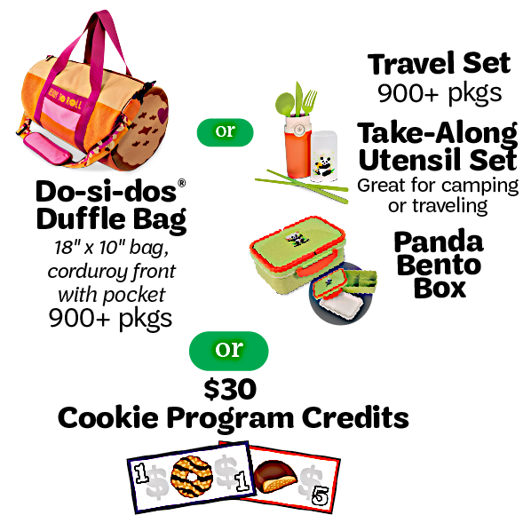
2025 Reward Selections
Notes:
Take a moment to look at the 2025 Reward selections.

Slide 10
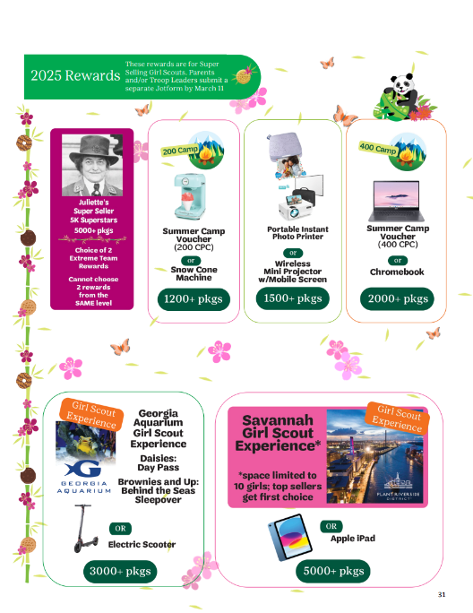
New 2025 Cookie Program
Extreme Team Rewards
Rewards are based on individual sales.
All Final Rewards above the 1200+ package level are considered Extreme Team Rewards. Extreme Team Reward are NOT cumulative.
At the 3000+ package level Girls can choose the Electric Scooter or the Georgia Aquarium Girl Scout Experience. Daisies will receive a Day pass. Brownies, juniors, cadettes, seniors and ambassadors will have the option to sleepover at the Georgia Aquarium.
The 2025 Savannah Girl Scout Experience is space-limited to 10 girls at the 5000+ package level. Top sellers will receive first choice.
Extreme Team Rewards are submitted via JotForm by the Girl Scout's parent/caregiver or Troop Leader by 11:59p.m. on March 11, 2025.
The Final Rewards must be submitted in eBudde by 11:59p.m. on March 11, 2025.
Cookie Program rewards acquired during participation in Product Programming will only be held for one year.
Notes:
Rewards are based on individual sales.
All Final Rewards above the 1200+ package level are considered Extreme Team Rewards. Extreme Team Reward are NOT cumulative.
At the 3000+ package level Girls can choose the Electric Scooter or the Georgia Aquarium Girl Scout Experience. Daisies will receive a Day pass. Brownies, juniors, cadettes, seniors and ambassadors will have the option to sleepover at the Georgia Aquarium.
The 2025 Savannah Girl Scout Experience is space limited to 10 girls at the 5000+ package level. Top sellers will receive first choice.
Extreme Team Rewards are submitted via JotForm by the Girl Scout's parent/caregiver or Troop Leader by 11:59p.m. on March 11, 2025.
The Final Rewards must be submitted in eBudde by 11:59p.m. on March 11, 2025.
Cookie Program rewards acquired during participation in Product Programming will only be held for one year.

Slide 11
Program Credits
Notes:
Cookie Program Credits are not 1 for 1 dollar equivalent ​
​
Cookie Program Credits are non transferable and ALL cookie Program Credits Expire on December 15, 2025.​

Slide 12
Parent/Caregiver Tasks
Register your Girl Scout for the 2025 membership year
Opt in to receive emails through myGS
Complete the Parent Permission Jotform
Submit all reorders on Sundays by 11:59pm by completing the Juliette Cookie order Jotform. Please note you will need your Digital Cookie orders information.
Complete the Extreme Team Rewards Jotform by March 11, 2025, at 11:59pm

Slide 13
Marketing your Business
Personalize
Personalize the Digital Cookie site by uploading weekly videos. Offer cookies through direct shipping and in person delivery.
Create
Create a digital marketing campaign on social media to stand out and spread the word.
Text or call
Text or call customers who may not be online to follow up for reorders.
Notes:
Marketing your cookie business online ​
​
Personalize the digital cookie site by uploading weekly videos​
​
Create a digital marketing campaign on social media​
​
Don’t forget to text or call customer who may not be online​

Slide 14
Dates to Know for the Parent/Caregiver
1/ 2 – Cookie Program Initial Orders Begin. Parent Permission Jotform due to council.
1/10 - Initial Order taking ends. Parent/caregiver Initial Order paper card and Reward orders must be submitted into Digital Cookie by 11:59pm.
3/9 - Cookie Program ends.
3/11 – Extreme Team Rewards due by 11:59 p.m.
*Youth coordinators will provide parents/caregivers with additional dates and deadlines specific to the troop.*
Notes:
​
Parents and caregivers should mark these important dates on their calendar. Knowing these dates will help parents and caregivers stay organized and facilitate a smooth cookie program for their Girl Scouts

Slide 15
Direct Delivery Process
Youth coordinator compiles Direct Delivery participant email list.
Parent/caregiver attends Regional meeting.
Youth Coordinator or Regional Product Program Manager manages program assisting parent/caregiver as needed.
Proceeds are deposited in a region-wide account.
Participating girls vote on use of proceeds within their region.
Established deadlines are maintained.
Notes:
The youth coordinator complies Direct Delivery participant email list.
The Parent/caregiver will attend a regional meeting
The Youth coordinator or regional Product Program Manager manages program by assisting parent/cargiver as needed
Proceeds are deposited in a region wide account
Participating girls vote on use of proceeds within their region
Established deadlines are maintained

Slide 16
Rewards Process
Delivered to regional office
Youth coordinator will contact parent/caregiver to arrange for pick up of rewards
Rewards are held at council office for one year
Program credits will be emailed directly to parent/caregiver from productprogram@gshg.org
Program credits expire on December 15th
Notes:
Rewards will be delivered to the regional office
The Youth coordinator will contact parent/caregiver to arrange for pick up of items.
Rewards are held at the regional council office for one year
Program credits will be emailed directly to the parent caregiver from productprogram@gshg.org

Slide 17
Helpful Reminders
Ensure your Girl Scout is Cookie Program Product Ready.
Parent/caregivers must submit Initial Order via Digital Cookie by 11:59pm on the date designated by the regional Product Program Manager but no later than January 10, 2025.
Council is requesting all rewards are picked up prior to the start of the 2026 Cookie Program to avoid forfeiture.
If the Parent Permission form is not completed and submitted by January 2, 2025, the Girl Scout will not be permitted to participate.
Money is due when the Girl Scout picks up cookies from council.
Notes:
Ensure your Girl Scout is Cookie Program Product Ready.
Parent/caregivers must submit Initial Order via Digital Cookie by 11:59pm on the date designated by troop leader but no later than January 10, 2025.
The council is requesting all 2025 Cookie rewards are picked up prior to the start of the 2026 Cookie Program to avoid forfeiture.

Slide 18
Resources
Cookie and Product Program Safety Activity checkpoints are on pages 81 through 83.
SafetyActivityCheckpoints2022-2024.pdf (gshg.org)
Notes:
Please check out all the resources available to you for the upcoming cookie program by www.girlscouts.org/cookieresources, www.LittleBrownie.com and www.gshg.org

Slide 19
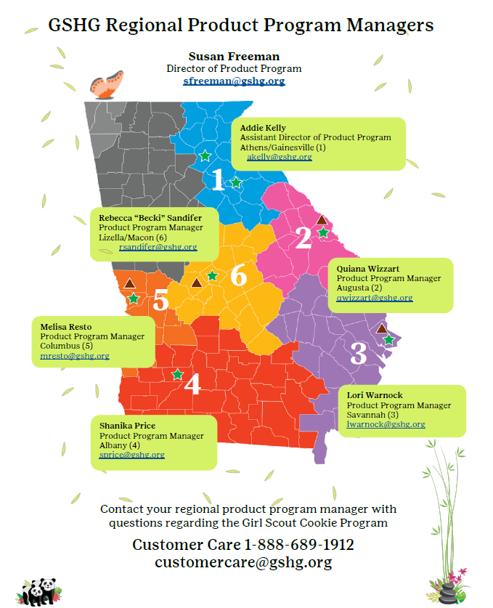
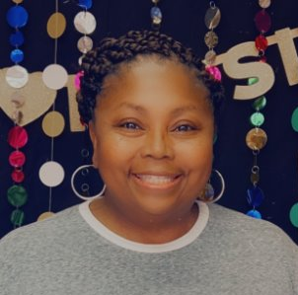
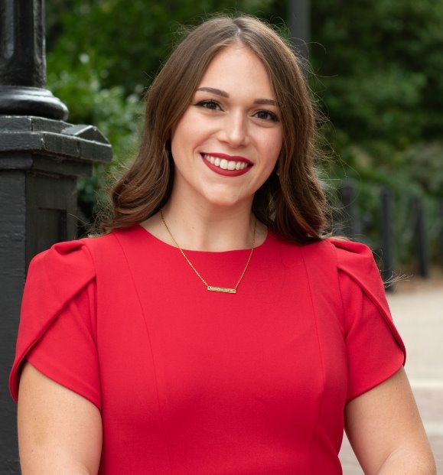
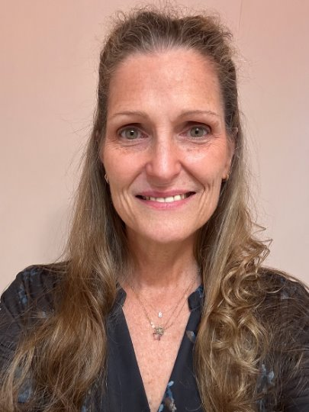
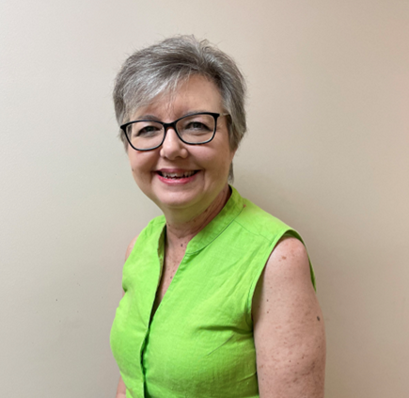
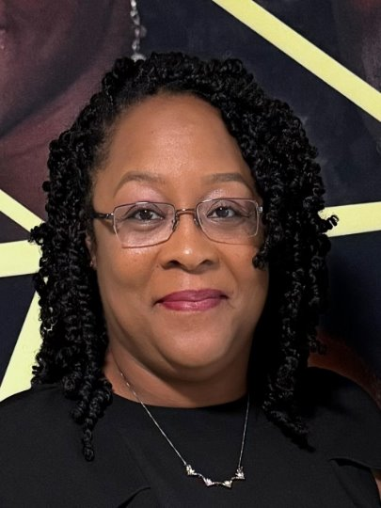
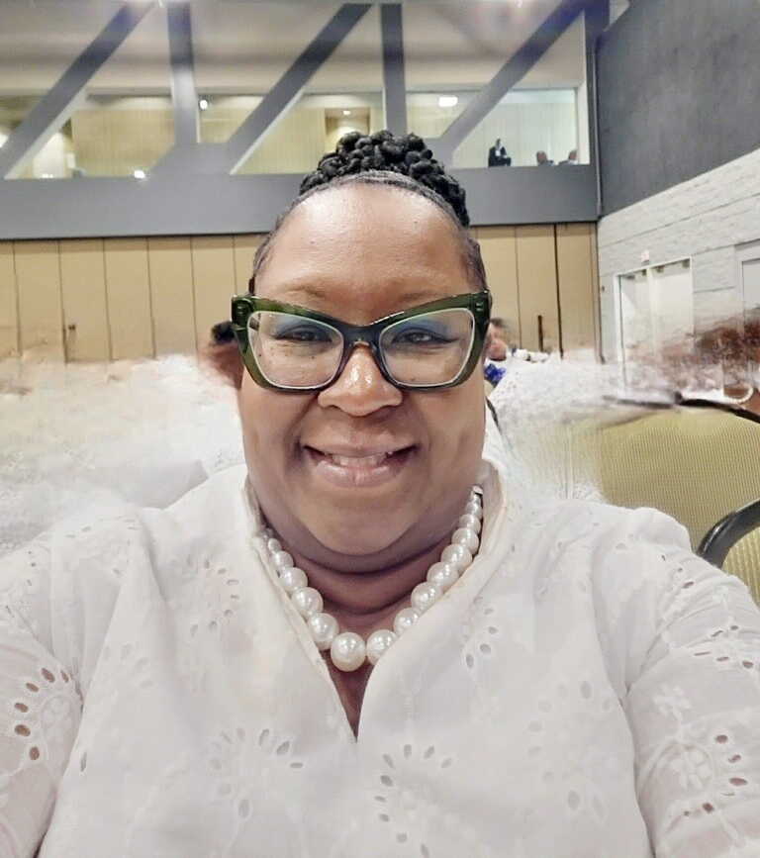
Get to Know the Product Program Team
LaDon Shaw
Chief Advancement Officer
lshaw@shg.org
Emergency hotline
1-866-236-7944
Notes:
Know your council ​
​
Your Service Unit Cookie Program Manager is your point of contact for the 2025 Cookie Season.
The Product Program Team will support them in providing you with the best experience. ​
​
We apologize in advance for any delays in response
as we spend less time at the office and
more time out in the field during the cookie program season. ​
​
If you need immediate assistance,
contact customer care at 1-888-689-1912
or at customercare@gshg.org​

Slide 20
Thank you for being a Pand-tastic GSHG Volunteer
Thank you!
Notes:
You are a Pand-tastic Parent.
Cookie season couldn’t happen without your hard work. ​
​
Thank you for volunteering your time to make a difference for the Girl Scouts in Historic Georgia.​
​
Let’s make this season the best one yet!​

