Slide 1
Girl Scouts of Historic Georgia 2025 Cookie Program Training
Notes:
Welcome to the 2024 Cookie Program Training. By taking this training you are choosing to embrace possibility this season with fellow Girl Scouts.

Slide 2
Product Program Abbreviations
IO – Initial Order
IRG/IRM-Individually Registered Member
PGA – Per Girl Average
SU – Service Unit
RPPM– Regional Product Program Manager
GOC – Gift of Caring
JFRC – Juliette Funds Request Committee
Notes:
Girl Scouts has its own language. Here are some must-know abbreviations for the Product Program Season.​
Gift of Caring is the programs through which Girl Scouts of Historic Georgia donates cookies.​
The Initial Order is the first order that is placed with Little Brownie Baker and arrives the beginning of February​
An IRM is a girl scout who is not a registered in a troop who we lovingly referred to as a juliette
The Service Unit is the area in which your Troop meetings are held. ​
Your regional product program manager is the staff member that manages product programming at your local Girl Scout office.

Slide 3
Juliettes/IRM’s are:
Individually registered (not attached to a troop)
Named after Juliette Gordon Lowe
Flexible Participation
Notes:
The Juliette pathway named for our founder provide a flexible way for Girl Scout to participate in programming. It allows the girl to participate when and how she wants to. Because the girl is not attached to her troop, she can adapt the program to fit her schedule and meet her needs.

Slide 4
Cookie Program Proceeds
Deposited in Council Wide account
Accessed via grant request
Grant requests voted on by Juliette Funds Request Committee (JFRC)
Funds can be transferred with Juliette if she joins a troop
Notes:
Cookie program proceeds are
Deposited in a council wide account
Accessed via grant request and voted on by the Juliette Funds Request Committee
Funds can be transferred with the Juliette if she joins a troop

Slide 5
Proceed Request Policy
Submit a grant application
Reviewed by JFRC for approval/disapproval
Total amount requested for the year can not exceed $500
Proceeds can be used for and in support of Girl Scout Programming
Funds are not given on a dollar-for-dollar basis
Notes:
When requesting use of funds
The parent caregiver must submit a grant application for proceeds
The committee will then review resulting in an approval or disapproval based of usage supporting Girl Scout Programming
Requests can not exceed $500 for the year
Funds are not given on a dollar for dollar basis

Slide 6
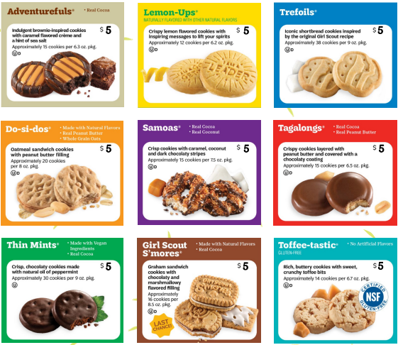
2025 Cookie Program Variety Line up
Cookie prices remain $5 a box.
This includes our specialty cookies S’Mores and Toffee-tastic.

Slide 7
GSHG Cookies contain
No High-fructose Corn Syrup
No Partially Hydrogenated Oils (PHOs)
Zero grams trans-fat per serving
RSPO Certified (mass balance) palm oil
Halal certification

Slide 9
Gift of Caring
2025 Cookie Donations will be sent to First Responders and Lineworkers who helped with the recovery after Hurricane Helene.
Girls who receive 50+ donations will receive the Gift of Caring charm
Girl Scouts who receive 100+ donations will receive the Bamboo Dangler with two Pop in Charms.
Notes:
Operation cookies from home and Gift of Caring will be combined for the 2025 cookie program season.
Volunteers will add all donated cookie booth sales packages to the GOC column in eBudde.
2025 Cookie Donations will be sent to First Responders who help with the recovery after Hurricane Helene.
Girls who receiving 50+ donations will receive the Gift of Caring charm
Girl Scouts who receive 100+ donations will receive the Bamboo Dangler with two Pop in Charms.

Slide 10
Notes:
This year GSHG Girl Scouts will embrace possibility with our new friend

Slide 11
5 Essential Skills learned through the Cookie Program
Goal Setting
Decision Making
Money Management
People Skills
Business Ethics
Notes:
The Girl Scout Cookie Program helps Girl Scouts develop real – world skills in five essential areas: Goal Setting, Decision Making, Money Management, People Skills and Business Ethics.
Girl Scouts learn how to set goals and create a plan to reach them.
Girl Scouts learn to make decisions on their own and as a team.
Girl Scouts learn to create a budget and handle money.
Girl Scouts find their voices and build confidence through customer interactions.
Girl Scouts learn to act ethically, both in business and life.
Visit www.gshg.org to learn more about inspiring cookie entrepreneurship

Slide 12
2025 Reward Selections
Notes:
If you have a

Slide 13
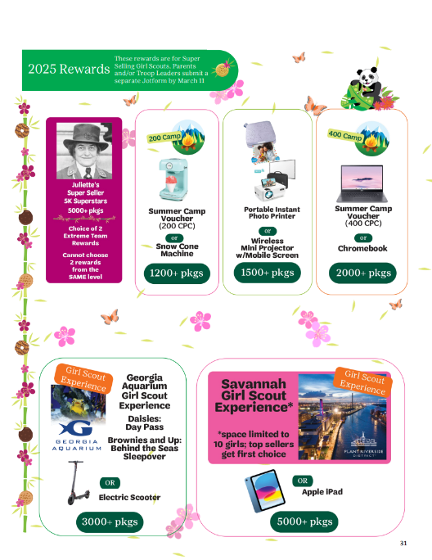
New 2025 Cookie Program
Extreme Team Rewards
All Final Rewards above the 1200+ package level are considered Extreme Team Rewards. This level is NOT cumulative.
At the 3000+ package level Girls can choose the Electric Scooter or the Georgia Aquarium Girl Scout Experience. Girls Brownie level and above will have the option to sleepover at the Georgia Aquarium.
The 2025 Savannah Girl Scout Experience is space limited to 10 girls (top sellers get first choice) who reach the 5000+ package level.
Extreme Team Rewards are submitted via Jotform by the Girl Scout's parent/caregiver and/or Troop Leader by 11:59 p.m. on March 11, 2025.
The Final Rewards must be submitted in eBudde by 11:59 p.m. on March 11, 2025.
Notes:
Rewards are based on individual sales.​
All Final Rewards above the 1200+ package level are considered Extreme Team Rewards. Extreme Team Reward are NOT cumulative.
At the 3000+ package level Girls can choose the Electric Scooter or the Georgia Aquarium Girl Scout Experience. Girls Brownie level and above will have the option to sleepover at the Georgia Aquarium.
The 2025 Savannah Girl Scout Experience is space limited to 10 girls at the 5000+ package level. Top sellers will receive first choice.
Extreme Team Rewards are submitted via JotForm by the Girl Scout's parent/caregiver or Troop Leader by 11:59p.m. on March 11, 2025.
Final Rewards must be submitted in eBudde by 11:59p.m. on March 11, 2025.
Cookie Program rewards acquired during participation in Product Programming will only be held for one year. ​

Slide 14
Program Credits
Notes:
Cookie Program Credits are not 1 for 1 dollar equivalent ​
​
Cookie Program Credits are non transferable and ALL cookie Program Credits Expire on December 15, 2025.​

Slide 15
2024-25 Fall Product & Cookie Program Crossover Patch
Earn 2024 Fall Personalized Patch​ ​ Sell 450+ packages of cookies and send 24+ digital cookie emails
Notes:
Girl Scouts can also earn a Crossover patch during the 2025 Cookie Program that compliments the 2024 Fall Product Personalized Patch. The crossover patch features Mei Lan the 2025 Cookie Program mascot and is earned by
Earning the 2024 Fall Personalized Patch​
Sending out 24+ Digital Cookie emails​
Selling 450+ packages of cookies during the 2025 Cookie Program
The patch will be shipped directly to the mailing address provided by the parent or caregiver after the initial login

Slide 16
Marketing your Business
Personalize
Personalize the Digital Cookie site by uploading weekly videos. Offer cookies through direct shipping and in person delivery.
Create
Create a digital marketing campaign on social media to stand out and spread the word.
Text or call
Text or call customers who may not be online to follow up for reorders.
Notes:
Marketing your cookie business online ​
​
Personalize the digital cookie site by uploading weekly videos​
​
Create a digital marketing campaign on social media​
​
Don’t forget to text or call customer who may not be online​

Slide 17
In Person
Lemonade Stand
Set up a cookie booth in front of a residence or private property to market cookies to customers who live close by
Use order card to ask local neighbors to purchase cookies.
Order Card
Notes:
if your troop is planning in-person cookie events,
there are lots of ways they can creatively rise to the occasion!
• In the Neighborhood: Girl Scouts can stay local and ask their neighbors to buy cookies using their cookie order card.
• Cookie Stands: Entrepreneurs can set up shop in front of a residence or private property and market their cookies to customers who live nearby.
• Cookie Booths: Preapproved locations like grocery stores, banks, malls or even parking lots are great places to set up a booth and connect with cookie lovers* . *
Cookie booths must be coordinated by Troop Product Managers, may only happen at council-approved locations and must be legally open to, accessible, and safe for all girls and potential customers. For more details, talk to your council and visit girlscoutcookies.org/troopleaders.

Slide 18
Smooth Cookie Pick up
Know the exact number of cases ordered of each variety.
Arrive at your scheduled pickup time.
Make sure you have enough vehicles to load your order.
Count your cookies and sign the receipt
Obtain a copy of receipt from your troop leader or cookie program manager.
Notes:
Follow these steps ensure you have a smooth cookie pick up.
Use the charts to determine the average cases of cookies you will be able to fit in the vehicle you will be transporting your inventory in and to guide you in placing your initial cookie order. ​
​
Know the exact number of cases ordered in each variety.
Arrive at your scheduled pickup time.
Make sure you have enough vehicles to load your order.
Line up your vehicles at the same time.
Check in and receive your pickup ticket.
Give your pickup ticket to the loader and count the cases as they’re loaded into your vehicle.
Sign for your order and take your receipt.
Please note damaged cookies are exchanged to the place you where you’ve picked up. For example if you pick up at the cupboard you return or exchange them at the cupboard.

Slide 19
Parent/Caregiver Tasks
Register your Girl Scout for the 2025 membership year
Opt in to receive emails through MyGS
Complete Parent Permission Form
Complete Parent Debt Procedure and submit to Regional Product Program Manager.
Complete the Extreme Team Rewards JotForm by March 11, 2025, at 11:59pm
Notes:
Registering their girl scout for the 2025 membership year
Ask you how you can help
Opted in to receive emails through MyGS
Completed the Parent Permission Form
Completed and submit the parent debt form with a wet signature.
Completed the Extreme Team Rewards JotForm by March 11, 2025 at 11:59pm

Slide 20
Dates to Know for the Parent/Caregiver
1/ 2 – Cookie Program Initial Orders Begin. Parent Permission jotform due to council.
1/10 - Initial Order taking ends. Parent/caregiver Initial Order paper card and reward orders must be submitted into Digital Cookie by 11:59pm.
3/9 - Cookie Program ends.
3/11 – Extreme Team Rewards due by 11:59 p.m.
*Troop leaders will provide parents/caregivers with additional dates and deadlines specific to the troop.*
Notes:
​
Parents and caregivers should mark these important dates on their calendar. Knowing these dates will help parents and caregivers stay organized and facilitate a smooth cookie program for their Girl Scouts

Slide 21
Helpful Reminders
Ensure your Girl Scout is Cookie Program Product Ready.
Parent/caregivers must submit Initial Order via Digital Cookie by 11:59pm on the date designated by the regional Product Program Manager but no later than January 10, 2025.
Council is requesting all rewards are picked up prior to the start of the 2026 Cookie Program to avoid forfeiture.
If the Parent Permission form is not completed and submitted by January 2, 2025, the Girl Scout will not be permitted to participate.
Money is due when the Girl Scout picks up cookies from council.
Notes:
Ensure your Girl Scout is Cookie Program Product Ready.
Parent/caregivers must submit Initial Order via Digital Cookie by 11:59pm on the date designated by troop leader but no later than January 10, 2025.
The council is requesting all 2025 Cookie rewards are picked up prior to the start of the 2026 Cookie Program to avoid forfeiture.

Slide 22
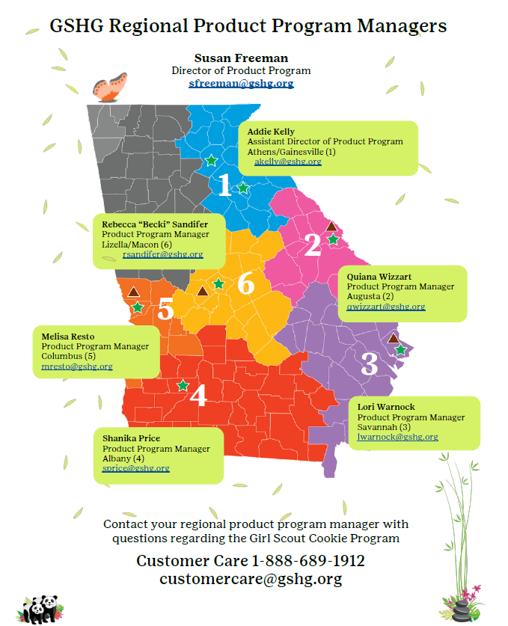
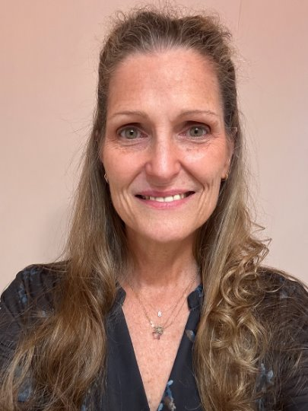
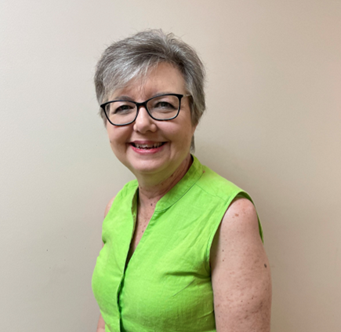
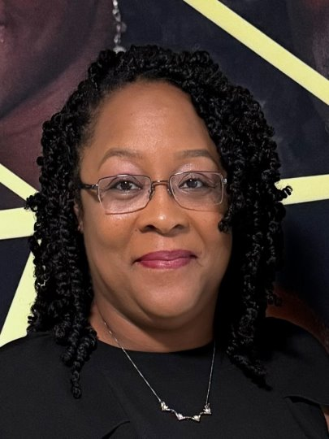
Get to Know the Product Program Team
LaDon Shaw
Chief Advancement Officer
lshaw@shg.org
Emergency hotline
1-866-236-7944
Notes:
Know your council ​
​
Your Service Unit Cookie Program Manager is your point of contact for the 2025 Cookie Season.
The Product Program Team will support them in providing you with the best experience. ​
​
We apologize in advance for any delays in response
as we spend less time at the office and
more time out in the field during the cookie program season. ​
​
If you need immediate assistance,
contact customer care at 1-888-689-1912
or at customercare@gshg.org​

Slide 23
Resources
Cookie and Product Program Safety Activity checkpoints are on pages 81 through 83.
SafetyActivityCheckpoints2022-2024.pdf (gshg.org)
Notes:
Go to www.gshg.org to access all the necessary forms for the 2025 Cookie Program.
Feel free to reach out to your Service Unit Cookie Program Managers with any questions or concerns

Slide 24
Thank you for being a Pand-tastic GSHG Volunteer
Thank you for being a
Pand-tastic GSHG Parent!!!!
Notes:
You are Pand-tastic.
Cookie season couldn’t happen without your hard work. ​
​
Thank you for allowing your Girl Scout to participate in the 2025 cookie program.​
​
Let’s make this season the best one yet!​

