Slide 1

January Mini-Monthly Training
Notes:
Welcome to the 2024 Cookie program Mini Training

Slide 2
Mini Training provide resources to guide you through each month of your Cookie Program. These monthly trainings are not required but recommended for troop leaders and cookie managers.
All trainings will be available on the GSHG
YouTube Channel for reference!
Notes:
Mini Trainings provide resources to guide you through each month of your Cookie Program. These monthly trainings are not required but recommended for troop leaders and cookie managers.
All trainings will be available on the GSHG
YouTube Channel and the GShG website for reference
Please note that links can be accessed throughout this training by holding the ctrl button on your keyboard and clicking the link.

Slide 3
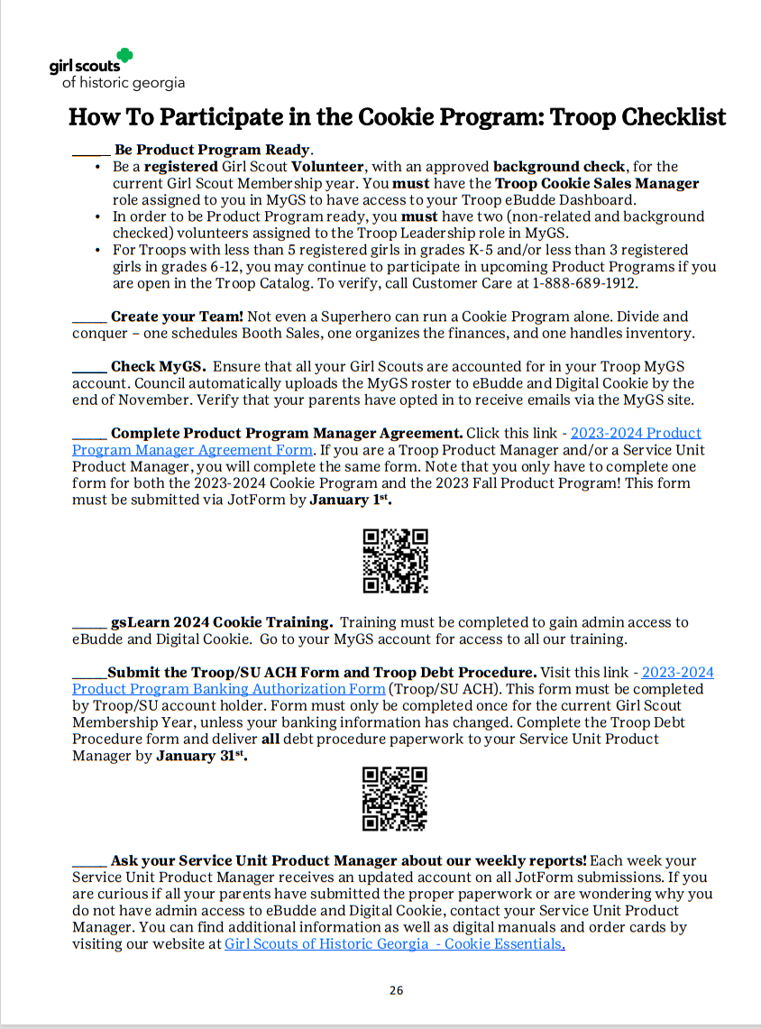
Verify that you are:
Registered for the 2024 Membership year
Been assigned the Troop Cookie Sales Manager Role
Assigned two non-related and background checked volunteers to your troop leadership team
Completed the gsLearn cookie Training
Completed the Product Program Manager Agreement
Collected Parent Debt forms from all your Girl Scouts parents
Notes:
To ensure you are product ready for the 2024 cookie season please verify that you
Are Registered and background checked for the 2024 Membership year
Have Been assigned the Troop Cookie Sales Manager Role in myGS
Have two non-related and background checked volunteers assigned to your troop leadership team
Have Completed the gsLearn cookie Training
Have Completed the Product Program Manager Agreement
Have Collected Parent Debt forms from all your Girl Scouts parents
Please note troop and parent debt procedures and ACH forms are due on January 31, 2024 by 11:59pm.

Slide 4
Required Forms For Troop Participation
Product Program Manager Agreement JotForm - Volunteers who want, or need access to eBudde must complete this by January 1st .
Withdrawal Authorization JotForm – Signer must complete form and enter troop bank account information in eBudde by January 31, 2024
Troop Debt Form – Page 30 of the Troop Cookie Manager Manual Must be printed and signed by both the troop product manager and troop leader. Person(s) completing this form take sole accountability for any uncollected cookie debt. Complete and submit the Troop debt form to your Product Program Manager by January 20, 2024.
Delinquent Form – Pages 27 – 28 of Troop Cookie Manager Manual
A completed Delinquent Form is required by Feb 16, 2024, for 1st ACH for each parent who does not submitted payment for cookies by the troop’s set deadline. Failure to complete delinquent forms will result in the Troop Product Manager maintaining sole responsible for Troop debt.
Notes:
Here is a list of Required Forms For Troop Participation
The product program agreement required to gain access to eBudde should be submitted as soon as possible,
The withdrawal authorization Jotform must by January 31st at 11:59pm. This form requires a voided check or banks statement including the routing and accounting number be uploaded into the system.
The troop debt form is a physical form that requires a wet signature in blue or black inkn and is due by January 20, 2024 no later than 11:59pm.. No scans or copies will be accepted. You will not receive your cookie order until council receives this form. A copy of this form can be found in your manual on page 30.
A completed Delinquent Form is required by February 16, 2024 for 1st ACH for each parent who does not submitted payment for cookies by the troop’s set deadline. Failure to complete delinquent forms will result in the Troop Product Manager maintaining sole responsible for Troop debt. A copy of this form can be found in your manual on pages 27 and 28.

Slide 5
January Dates
  January 1st - Cookie Program starts, and your troop can begin selling!
  Digital Cookie: For Parents & Caregivers – Approving Orders
  Digital Cookie: For Parents & Caregivers – Initial Login
January 1st – January 11th - the Initial Order taking period of the cookie program. After January 11th, all orders will count towards final rewards.
  January 12th –Regional Product Program Manager submits the Initial Order and Initial Rewards via eBudde. This cookie order includes all of the orders collected during the Initial Order period, your first week of Booth Sales and any extras you would like to order between now and when the cupboard opens.
  Digital Cookie: For Parents & Caregivers – My Cookies-Initial Order
January 20th – Please have all booth request forms submitted to your Product Program Manager.
Notes:
Jump into January Prepared for Cookie Season by marking these dates on your calendar
January 1st marks the start of The 2024 Cookie Program. Orders taken between January 1st and January 11th are counted towards the Initial Order Sales.
On January 12th your Regional Product Program Manager will submit your initial order and initial rewards The cookies ordered should include cookies needed for booth sale and extra you would like to have on hand until the cupboards open.
Please have all your booth request to your Regional Product Program Manager by January 17th.

Slide 6
January 1st Cookie Program starts!
Digital Cookie: For Parents & Caregivers – Approving Orders
Digital Cookie: For Parents & Caregivers – Initial Login
eBudde Overview
eBudde: Cookie Tech Portal
eBudde Volunteer Training: App Dashboard
Digital Cookie: For Volunteers – Troop Dashboard
Notes:
January 1st – January 11th is the Initial Order taking period for GSHG’s 2024 cookie program.
After January 11th, all orders will count towards final rewards.
Note that January 11th is also the troop opt out deadline!
Only troops with a majority of older girls can choose to opt out of rewards in exchange for extra proceeds.

Slide 7
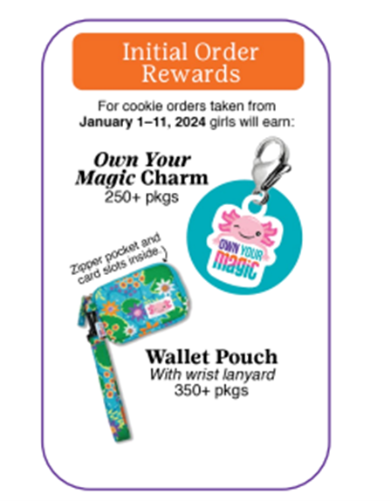
January 12th - Initial Order and Initial Rewards Submission
Troop submits the Initial Order and Initial Rewards via eBudde. This cookie order includes all orders collected during the Initial Order period, your first week of Booth Sales and any extras you’d like to order between now and when the cupboard opens.
eBudde Volunteer Training: Initial Order
Budde Volunteer Training: Girl Rewards
Digital Cookie: For Parents & Caregivers – My Cookies-Initial Order
Notes:
January 12th Troop will submit the Initial Order and Initial Rewards via eBudde.
This cookie order includes all orders collected during the Initial Order period, your first week of Booth Sales and any extras you’d like to order between now and when the cupboard opens.

Slide 8
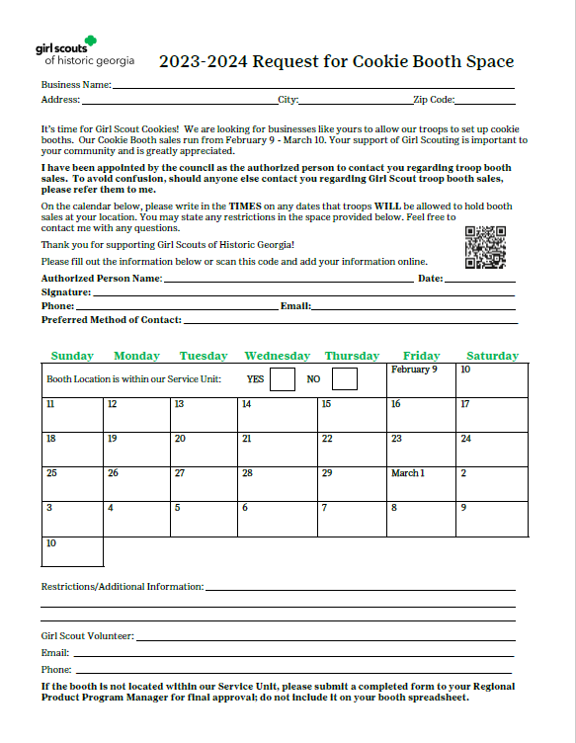
January 17th –
Cookie Booth Request Forms Due To Council
Cookie booth Request forms must be submitted to council on January 17, 2024, by 11:59 pm.
Submit hard copy to council or submit through the cookie app.
Notes:
Cookie booth requests must be submitted to council on January 17, 2024, by 11:59 p.m.
Cookie booths can be submitted by using this form or through the cookie app.

Slide 9
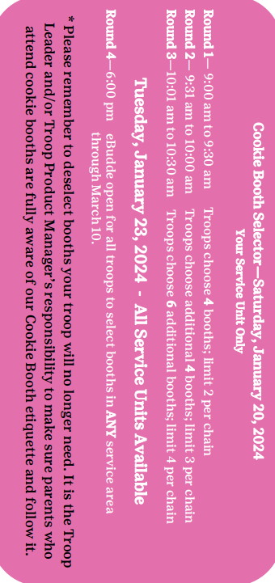
January 20th –
Cookie Booth selections
eBudde Volunteer Training: Council Booth Sales
Request for Cookie Booth Sale Dates 2024
eBudde Volunteer Training: Troop Booth Sales
23-24 Request for Cookie Booth Sale Space
Notes:
The cookie booth flow chart can be found in your Troop Cookie Manager Manual on page 18
Cookie Booth Selections will take place on Saturday, January 20, 2024, starting at 9:00 am and ending at 10:30 am. Booths selected on January 20th will be only in your service unit areas.
Booth selections will reopen on Tuesday, January 23, 2024, at 6:00pm. This is when you will be able to select booths from all service unit areas.

Slide 10
Go to www.gshg.org, to access eBudde, Digital Cookie and our mini trainings. These videos are extremely helpful and provide you with a proper breakdown of what each platform can do. eBudde Training Videos
Digital Cookie Training Videos
Mini Monthly Trainings
Additional Available Training
Notes:
Go to www.gshg.org, to access eBudde, Digital Cookie and our mini trainings. These videos are extremely helpful and provide you with a proper breakdown of what each platform can do.

Slide 11
Cookie Selling Tools and Resources | Girl Scouts
Little Brownie Bakers
Notes:
Please scan these QR codes to access the following resources from Girl Scouts and Little Brownie Bakers:
About Girl Scout Cookies®
Troop Leader Resources
Cookie Business Badges
Cookie Entrepreneur Family Pin
Digital Cookie®
Digital Marketing Basics
FAQs and Nutrition Information
Girl Scouts® Cookie Captains and Cookie Rookies
Social Media Tools and Graphics
Own Your Magic Resources
Resources for Girl Scouts to Grow Their Cookie Businesses
Cookie History

Slide 12
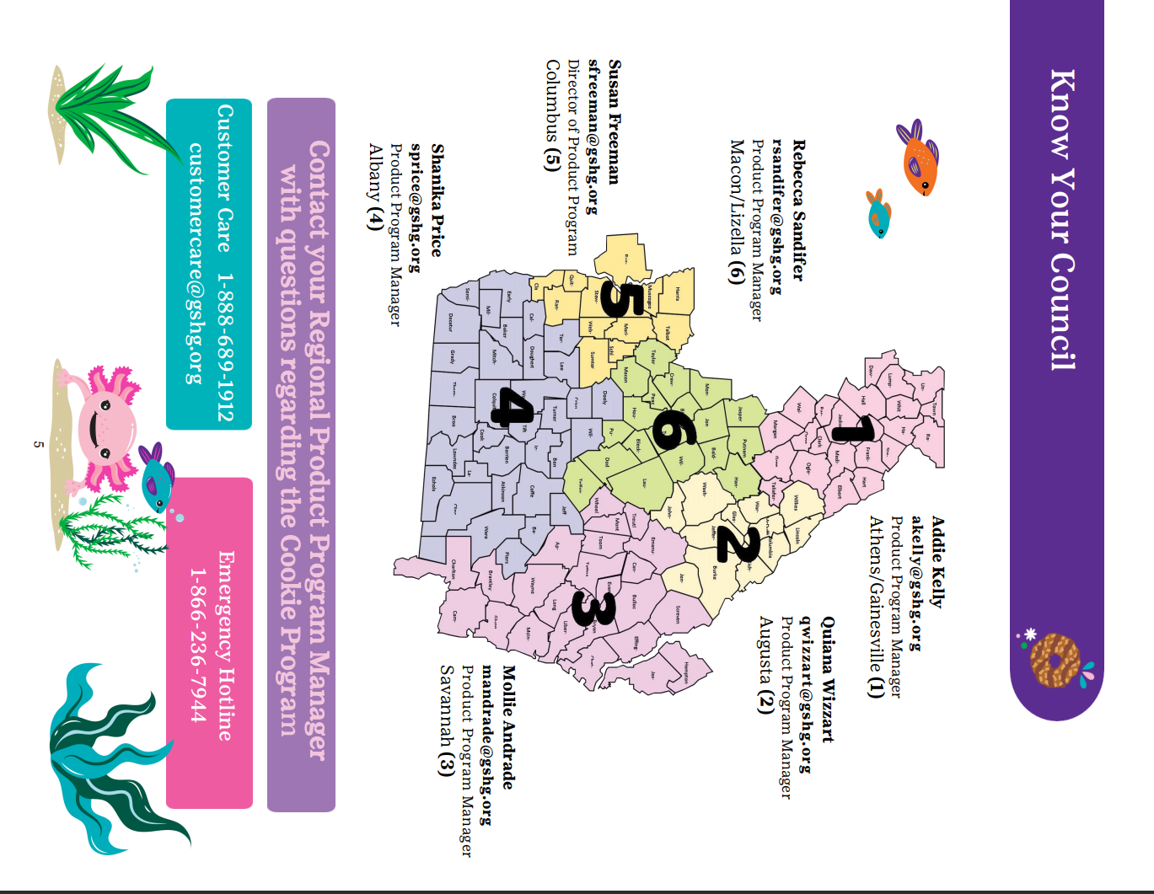
Know your Council
Customer Care 1-866-689-1912
customercare@gshg.org
Emergency hotline
1-866-236-7944
Notes:
We appreciate you working with us to make sure girls have an axolotl fun during the 2024 Cookie Program. Please contact you customer care or your Product Program Manager with any issues,.
Please note that we are experiencing a high volume of emails and phone calls and will get back to you as soon as we can, Thank you for your patience and thank you for being a part of the 2024 Cookie Program Experience.

