Slide 1



2023
Fall Product
Program
Parent Training

Slide 2






Benefits of Participating in
Fall Product Program
Goal Setting
People Skills
Decision Making
Business Ethics
Money Management

Slide 3


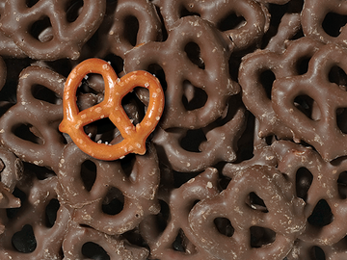
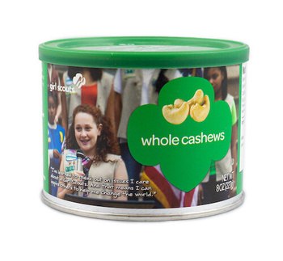


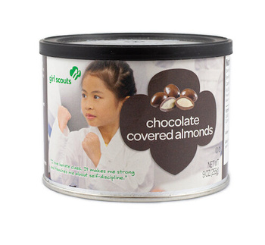









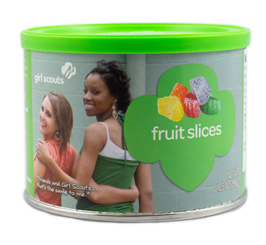
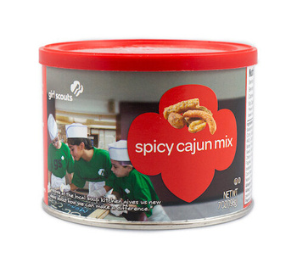
2023 Fall Product Selection

Slide 4
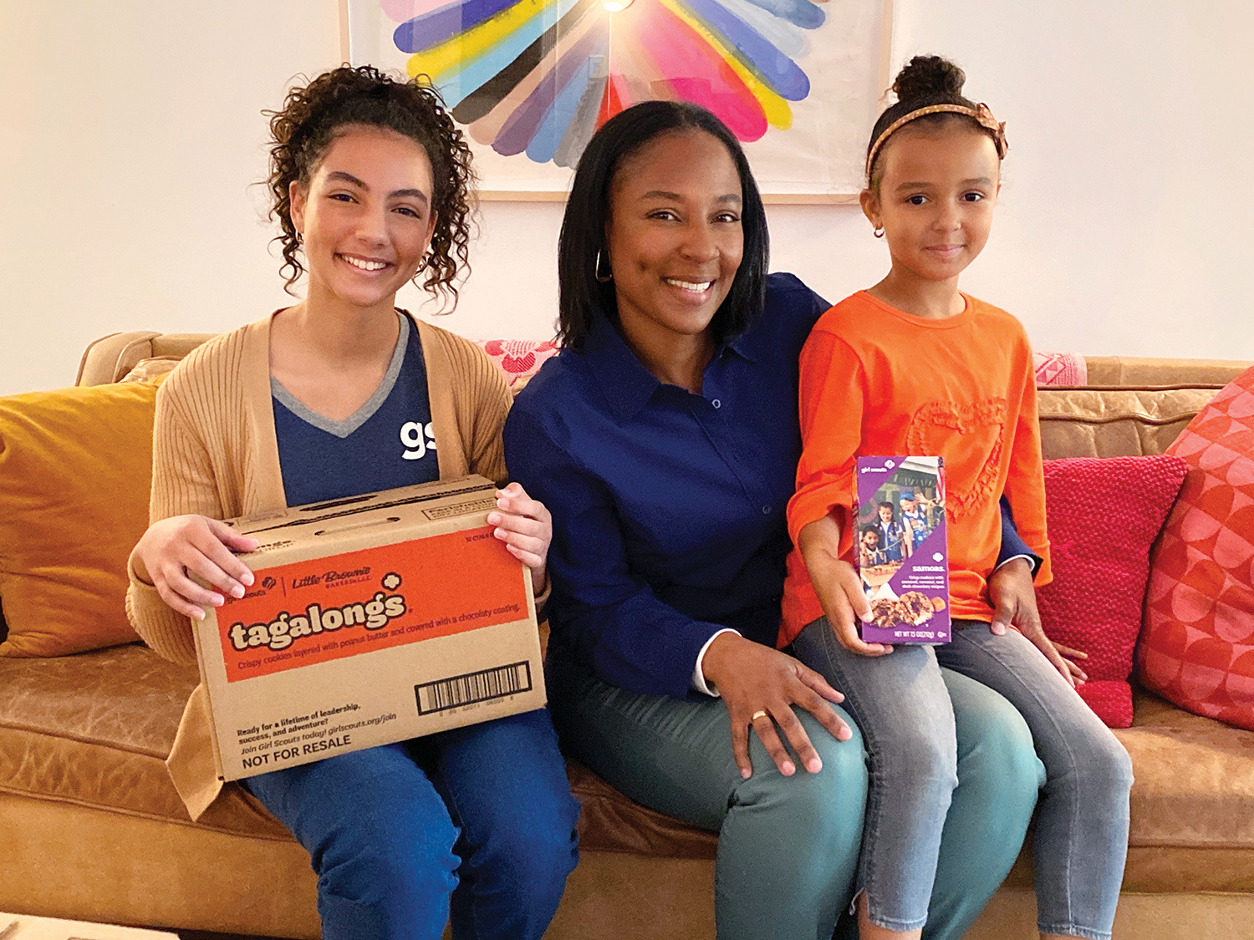
Parent
Participation
  Register your girl for 2023-24 MY
  Opt in to receive email
  Pick up Fall Product items from Troop Product Program Manager
  Complete the online Parent Permission Form
  Obtain your Troop #, SU, and Region
  Register for your M2 account on September 23rd
  Help your Girl Scout Create an Avatar
  Enter paper order into the M2 System by November 1st

Slide 5


Two Ways to Participate
In-Person
Utilizes Nut Order Card
Online
Option to Ship
Directly to Customer

Slide 6





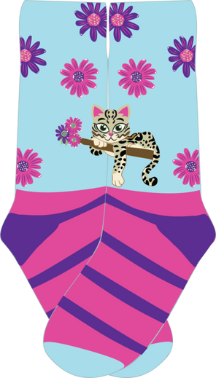


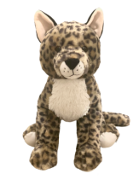
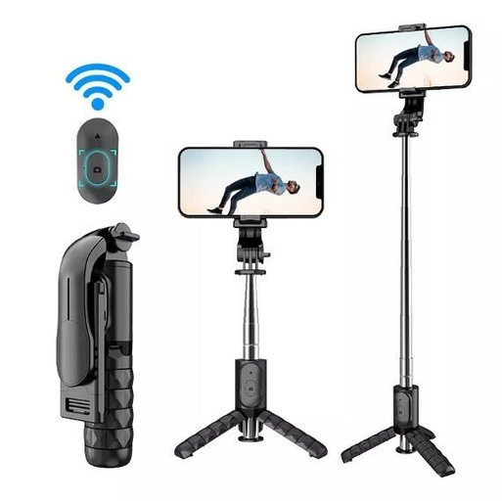


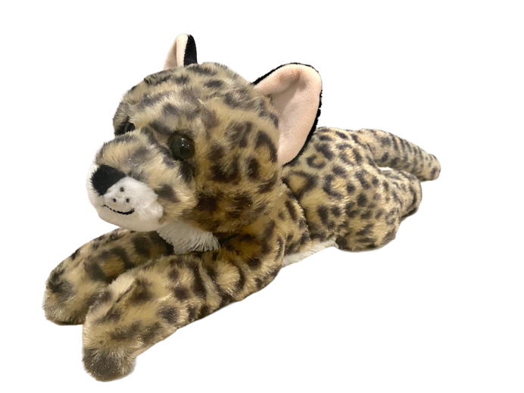
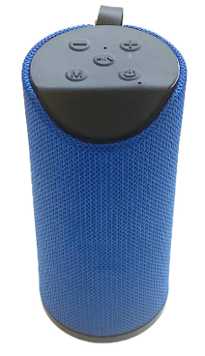
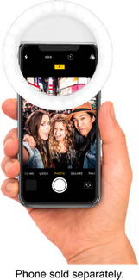
2023 Fall Product Rewards

Slide 7



Personalized Patches
Create your avatar.
Use “Share My Site” to invite friends and family to
shop online at your site.
Sell 4 magazines, 40+ nuts/candies, and send 18 emails.
Personalize your patch by choosing from two scenes.
You have the option to select from safari or Girl Scout attire.

Slide 8

Crossover Patch Requirements
  Earn the Personalized Patch
  Send 18+ emails during the
2024 Cookie Program
  Sell 325+ packages of cookies during the 2024 Cookie Program

Slide 9

Troop members collectively decide
on how to use proceeds
Product
Program
Proceeds
Deposited into troop account

Slide 10

Things to Remember
  Collect money when customer places order
  Verify all orders prior to submission
  No reorders
  Submit money to troop leader frequently

Slide 11

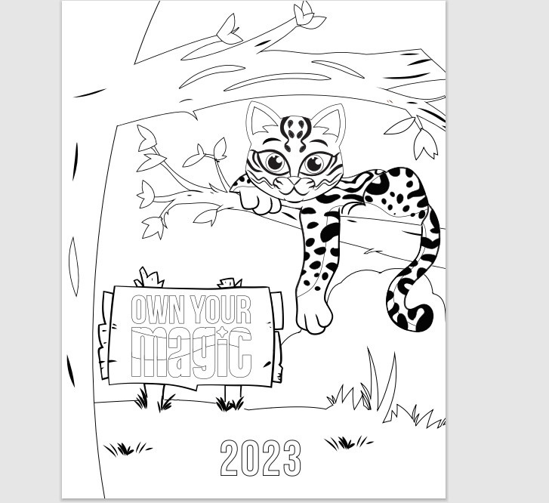

Coloring
COntest

Slide 12

How to
Get Started
Online to purchase nuts and chocolates, magazines, Tervis Tumblrs and BarkBox
In-person with nut order card

Slide 13

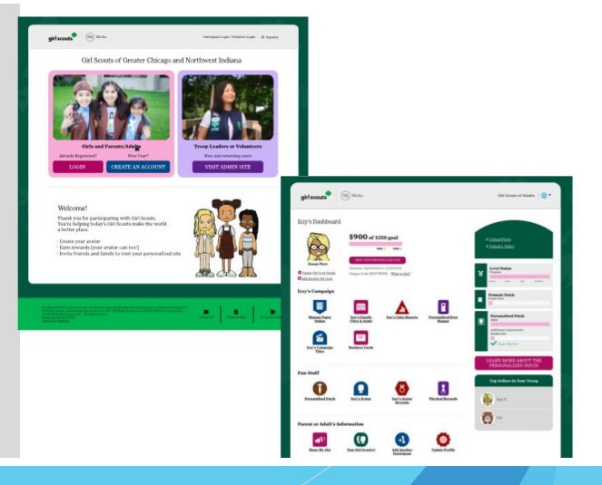
Girl Scout’s
Platform
Set Up
Preferred Email Address
Confirm Membership
Highlight Girl Scout Goals
Build an Avatar
Include video

Slide 14
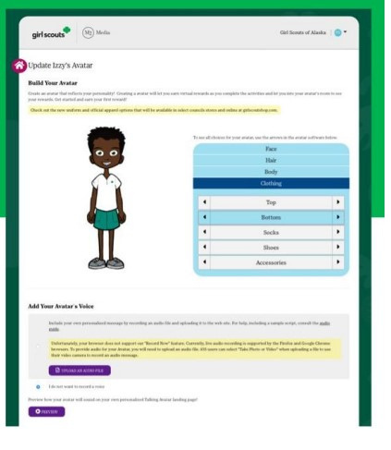





Girl Scout’s Personalized Experience
Design an Avatar

Slide 15
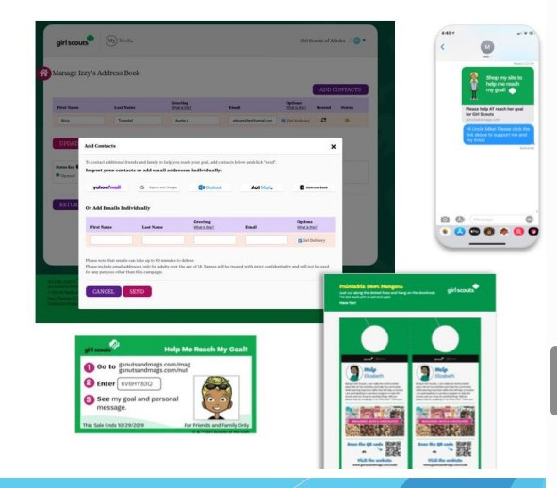
Tools to
Run a
Business
Send emails
Share My Site with social media and texting
Printable business cards
Door hangers with QR codes

Slide 16
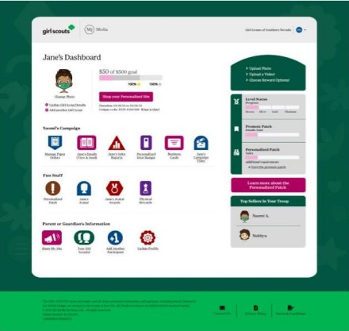
Participant’s Dashboard
Additional emails/social
media/texts
Girl Scout’s avatar room
with virtual rewards and
troop photo
Manage nut card order entry
Select rewards
Sales reports

Slide 17

Important Dates
to Know
  9/23 Fall Product Program KICKS OFF
  11/1 Fall Product Program Ends at 11:59 PM
    Paper order entries due
  11/15 - 11/17 Nut and chocolate items will be delivered to Service Units sites

